Slide 1
Smart water management
Team members :
Gokul A
Vijay M
Gowtham R
Dhanajezhiyan N

Slide 2
Here we bring mobile application for water management system in rural and urban areas as we know that there are many problems are facing in rural areas related to canal supply of water for irrigation no arrangement of water within particular distance areas like no wells ,no hands pumps ,no canals ,no ponds . So with this app people will directly communicate with the government officials and similarly in urban areas we have seen that the water scarcity problem in happening now a days and like water distribution management problems
Introduction :

Slide 3
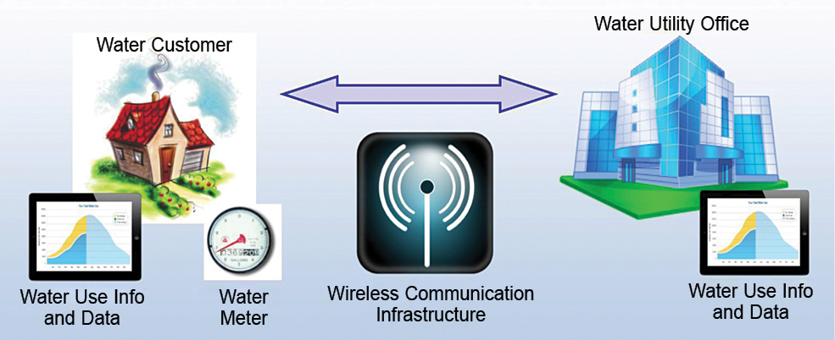
The importance of smart water management :
Water is one of our most precious resources, essential for life on Earth. However, with increasing population growth and climate change, the demand for water is rapidly outpacing supply. It is crucial that we manage our water resources efficiently to ensure that we have enough for everyone now and in the future.
Smart water management practices can help us achieve this goal by reducing waste, improving efficiency, and conserving water. By implementing these practices, we can ensure that our water resources are used wisely and sustainably.

Slide 4
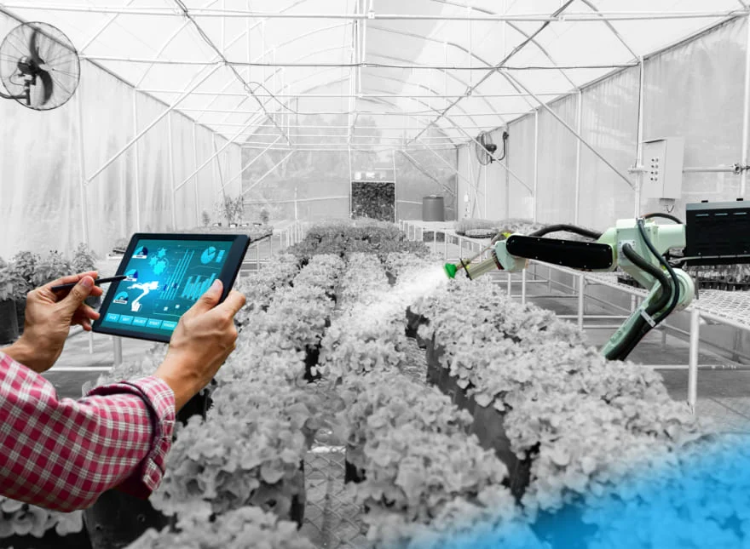
Examples of smart water management :
In the city of Melbourne, Australia, the government implemented a smart water management system that includes rainwater harvesting, storm water recycling, and wastewater treatment. This has resulted in a significant reduction in water consumption and a more sustainable use of resources.

Slide 5
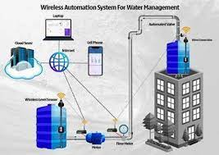
The Role of Technology in Smart Water Management :
Technology plays a crucial role in smart water management. By utilizing advanced sensors and data analytics, we can monitor water usage and identify areas for improvement. For example, smart irrigation systems can automatically adjust watering schedules based on weather patterns and soil moisture levels, reducing waste and saving resources.
In addition, technology can help us better understand and manage our water supply. Remote sensing technologies allow us to track water quality and quantity in real-time, while predictive modeling tools can help us anticipate changes in water availability and plan accordingly.

Slide 6
Conclusion :
In conclusion, smart water management is crucial for the future of our planet. By implementing efficient practices and utilizing technology, we can ensure that we have enough water resources to sustain life and support economic development.

